Slide 1

Healing Music
-あああ-

Slide 2
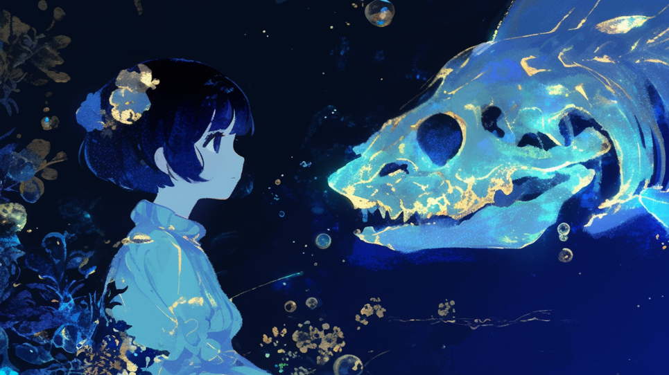
Healing Music
-あああ-

Slide 3
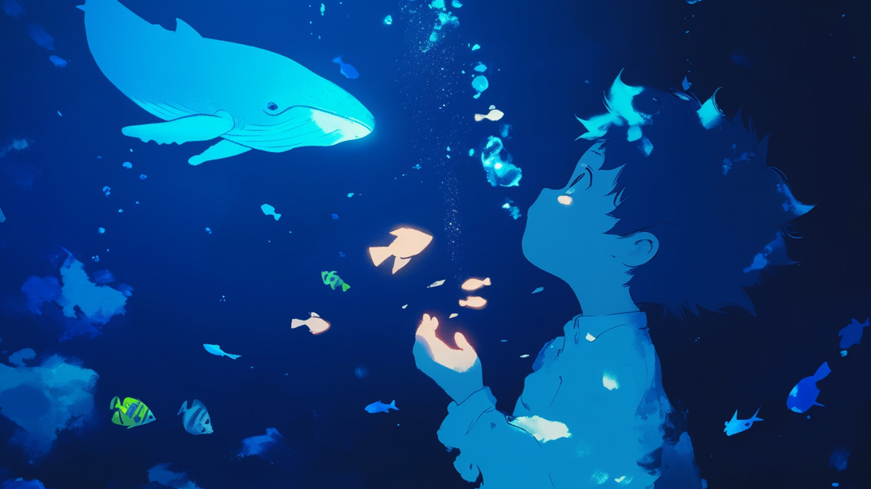
Healing Music
-あああ-

Slide 4

Healing Music
-あああ-

Slide 5
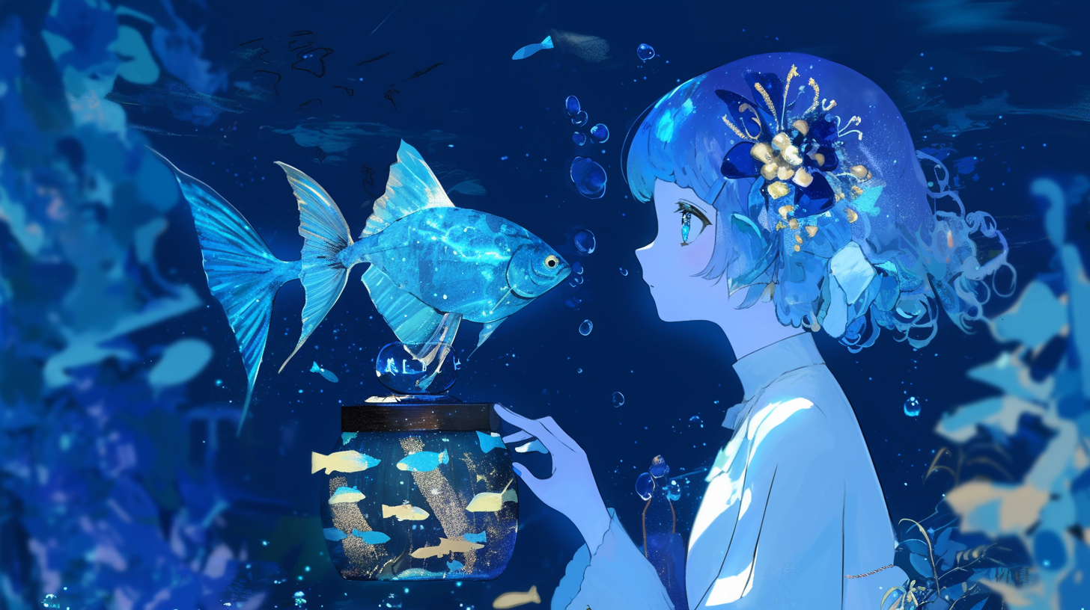
Healing Music
-あああ-

Slide 6
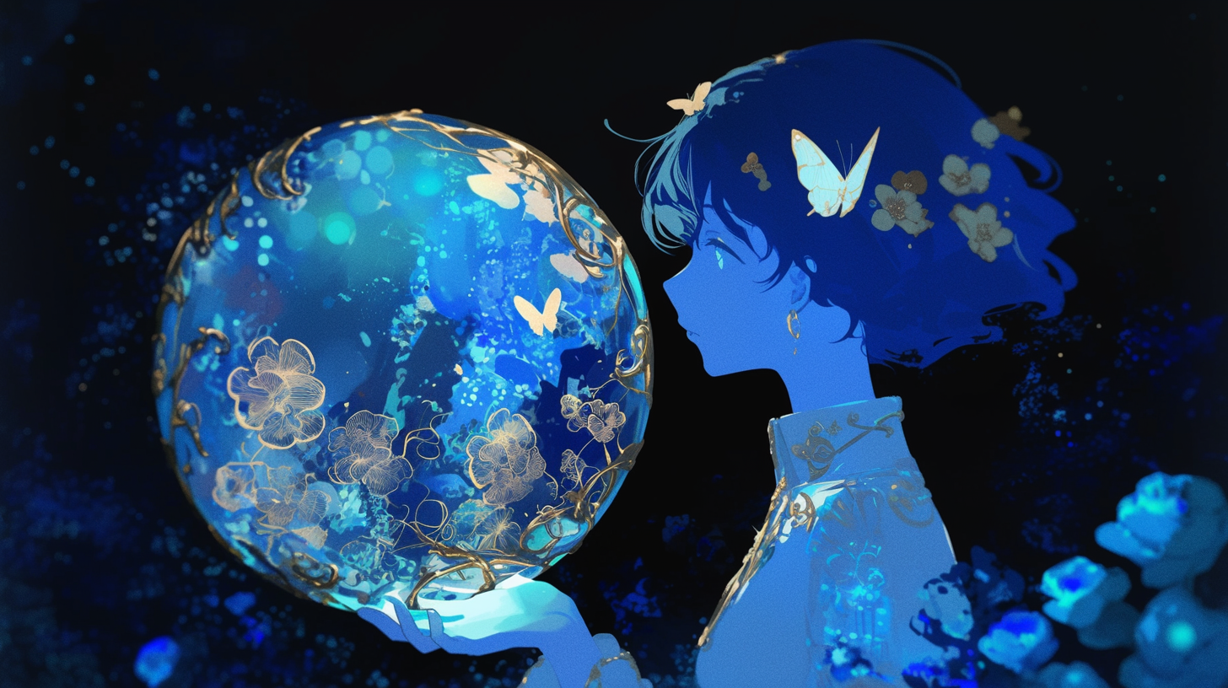
Healing Music
-あああ-

Slide 7

Healing Music
-あああ-

Slide 8

Healing Music
-あああ-

Slide 9
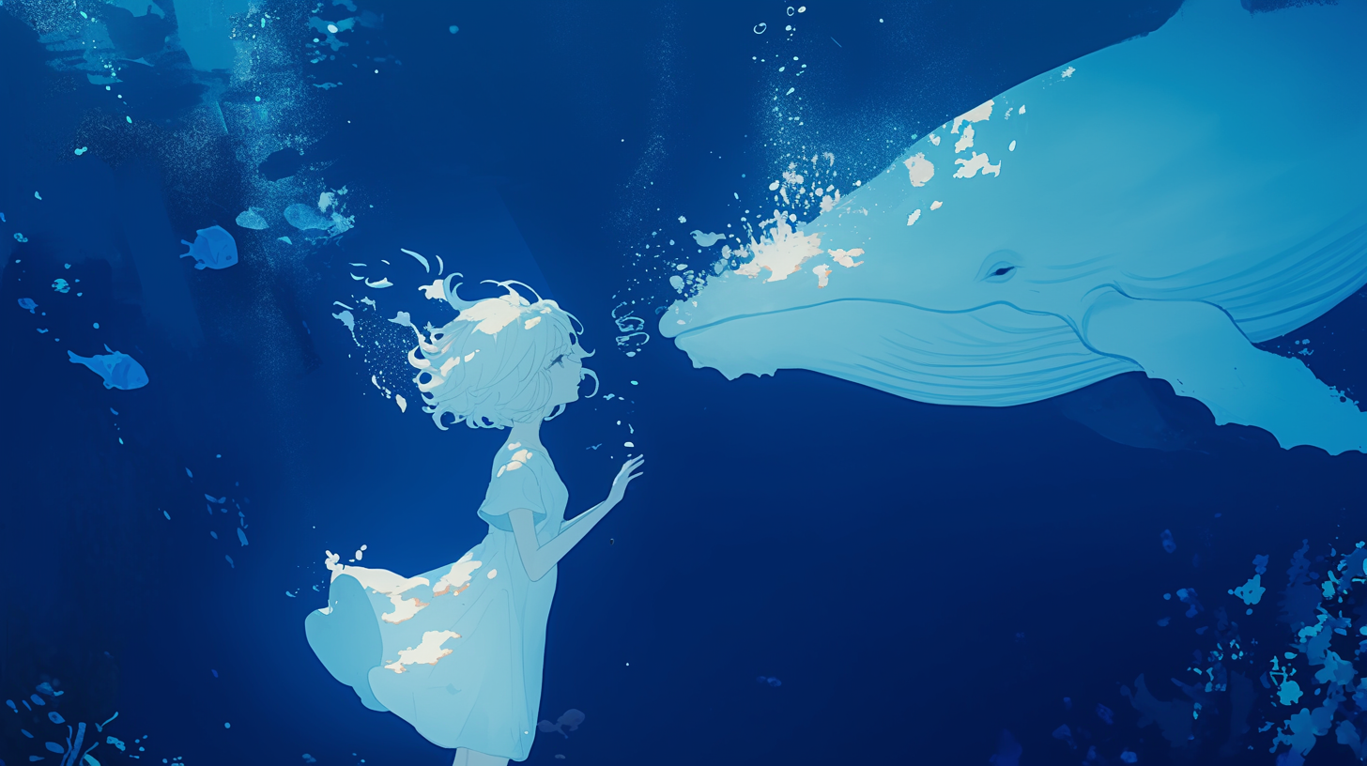
Healing Music
-白鯨の-

Slide 10
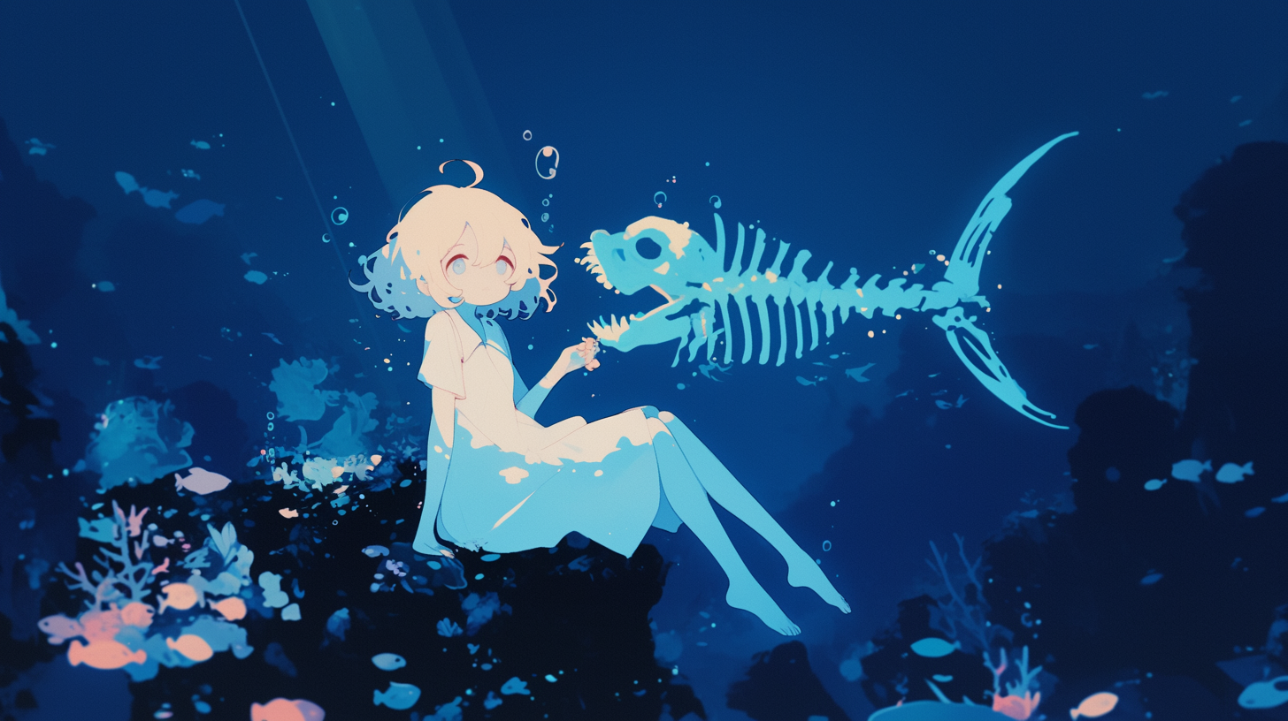
Healing Music
-あああ-

Slide 11
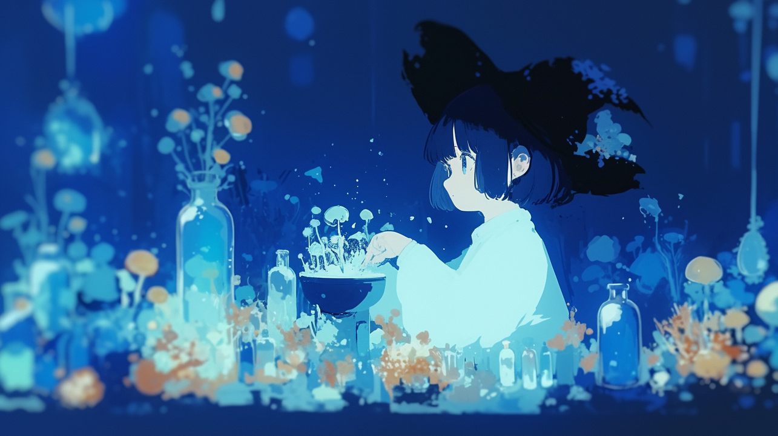
Healing Music
-水底の研究室-

Slide 12
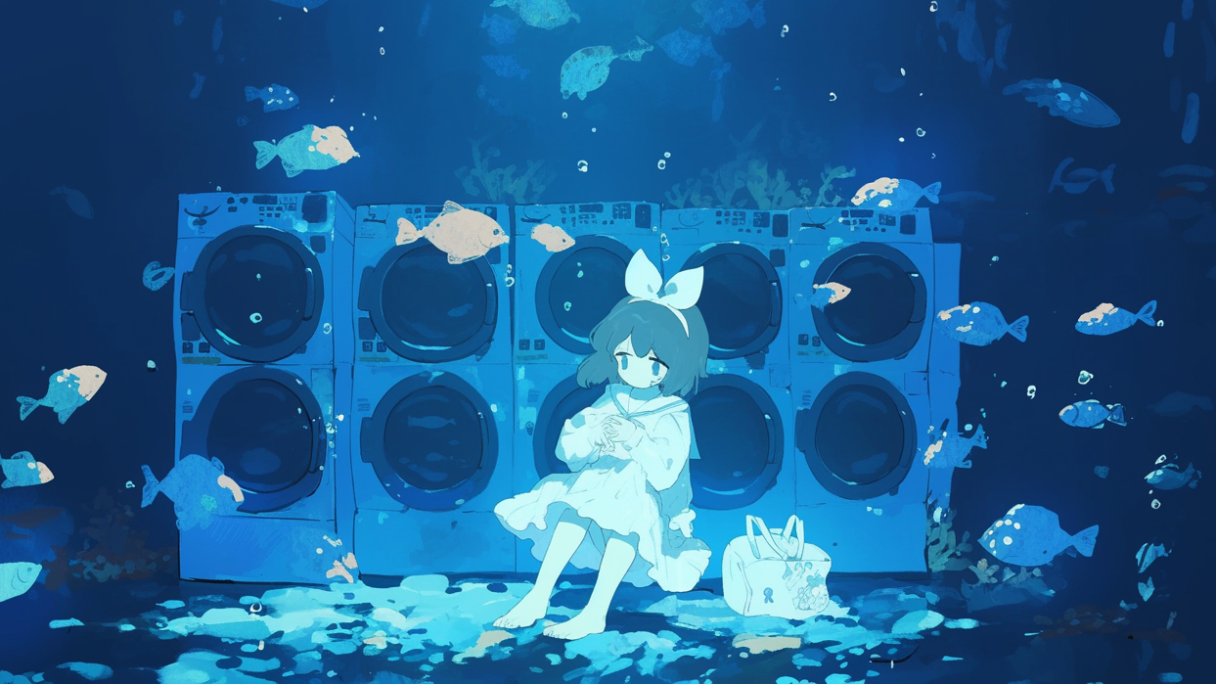
Healing Music
-あああ-

Slide 13

Healing Music
-あああ-

Slide 14
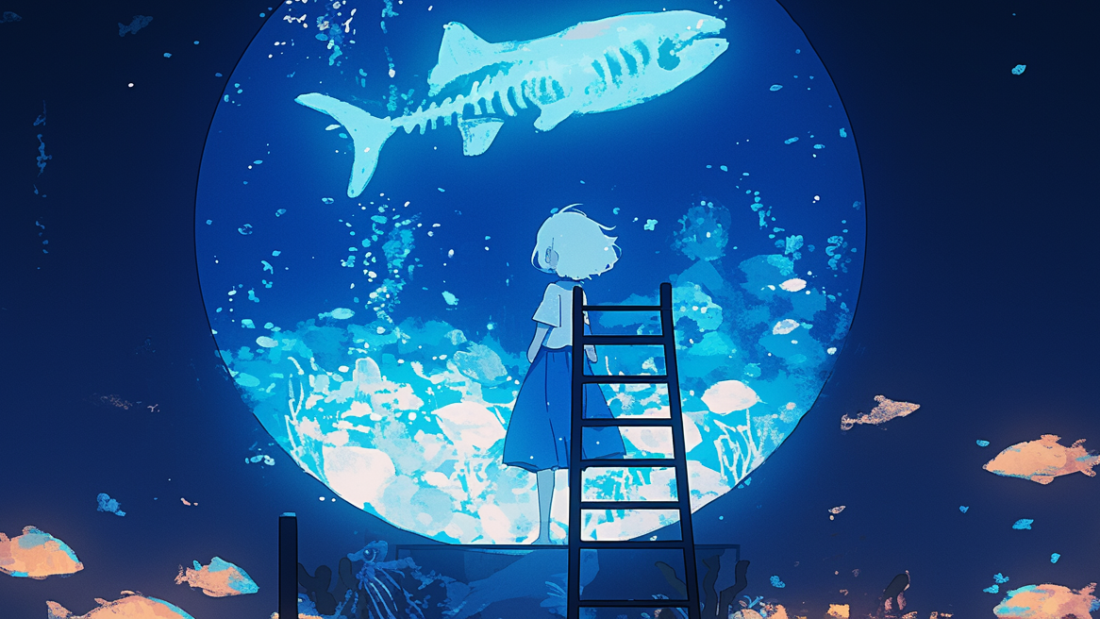
Healing Music
-あああ-

Slide 15

Healing Music
-あああ-

Slide 16
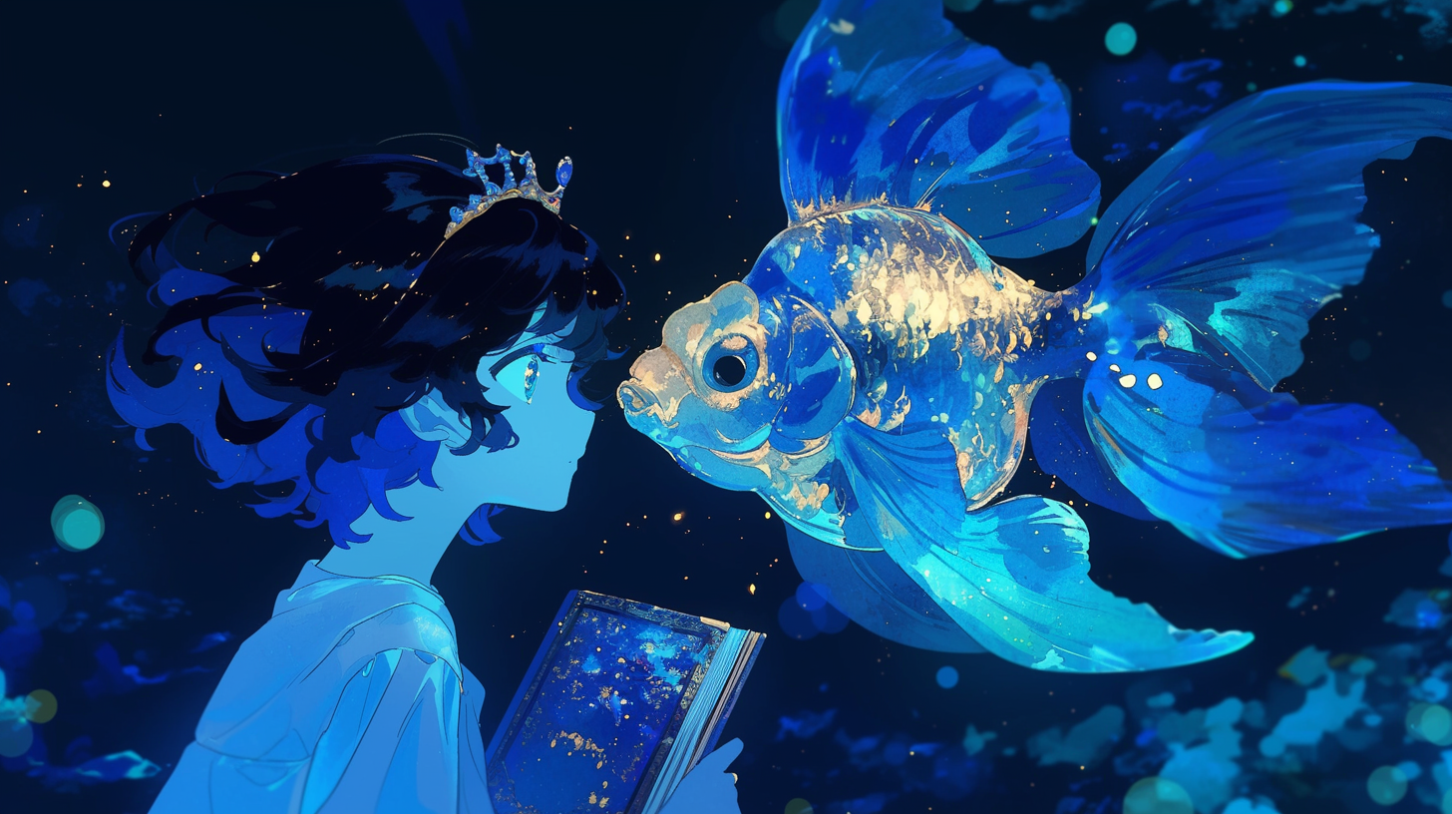
Healing Music
-あああ-

Slide 17
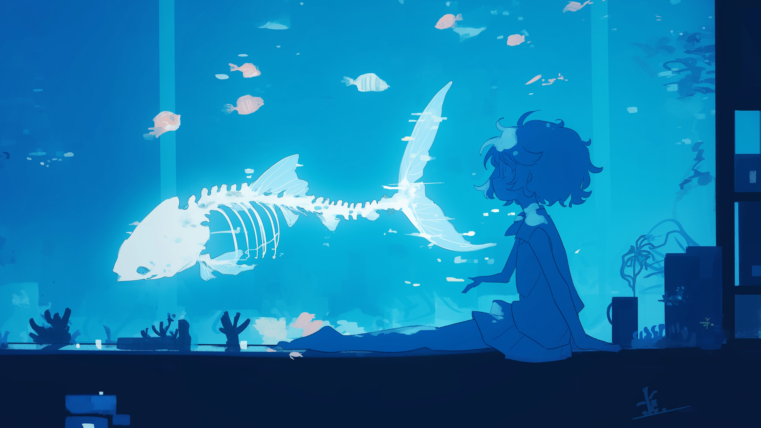
Healing Music
-あああ-

Slide 18

Healing Music
-あああ-

Slide 19
Healing Music
-あああ-

Slide 20
Healing Music
-あああ-

Slide 21
Healing Music
-あああ-

Slide 22
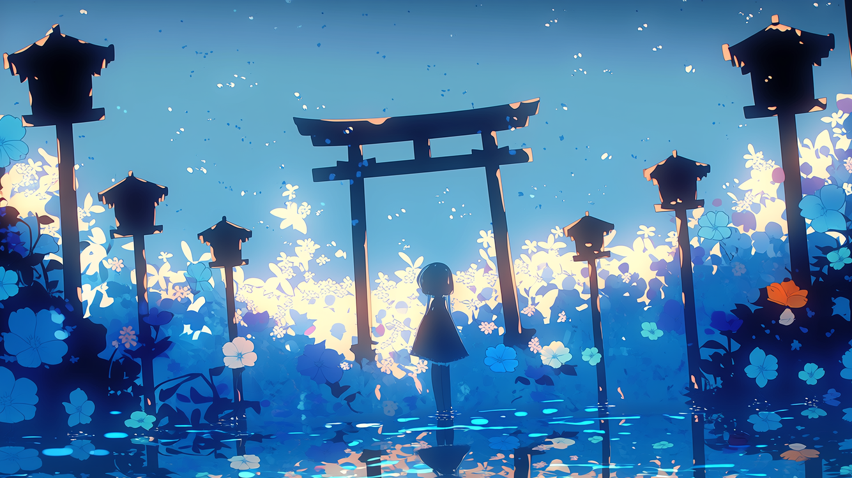
Healing Music
-神域の迷い子-

Slide 23
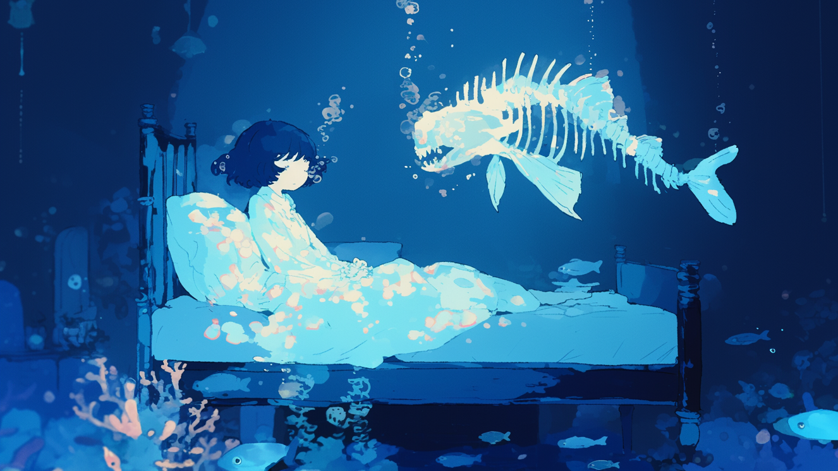
Healing Music
-水圧と体温-

Slide 24

Healing Music
-古代魚と眠る夜-

Slide 25
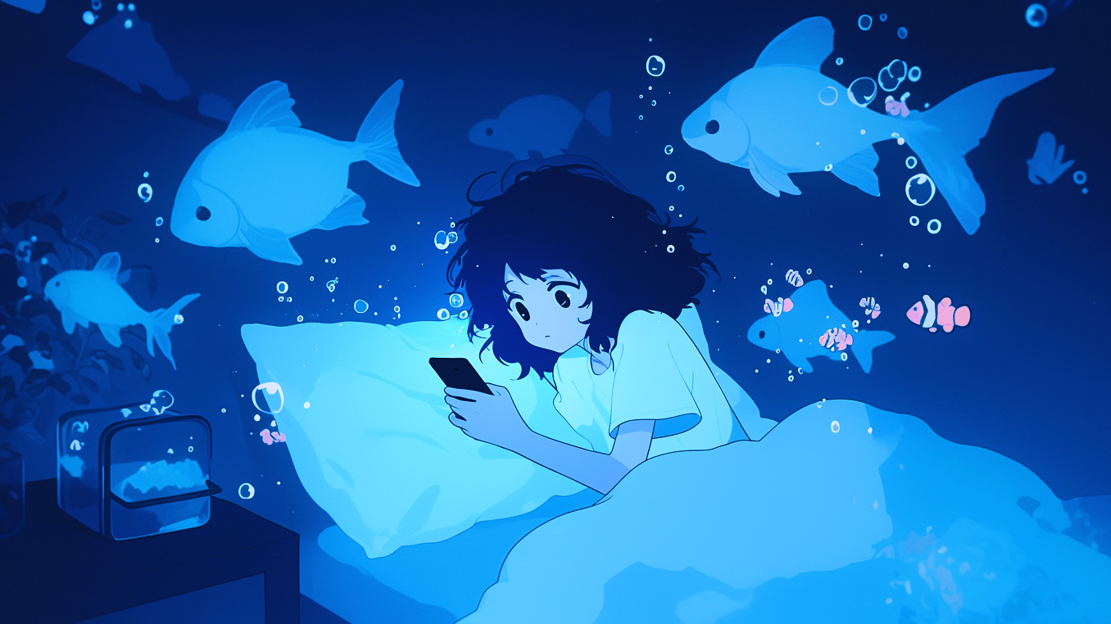
Healing Music
-眠れない夜の航海-

Slide 26
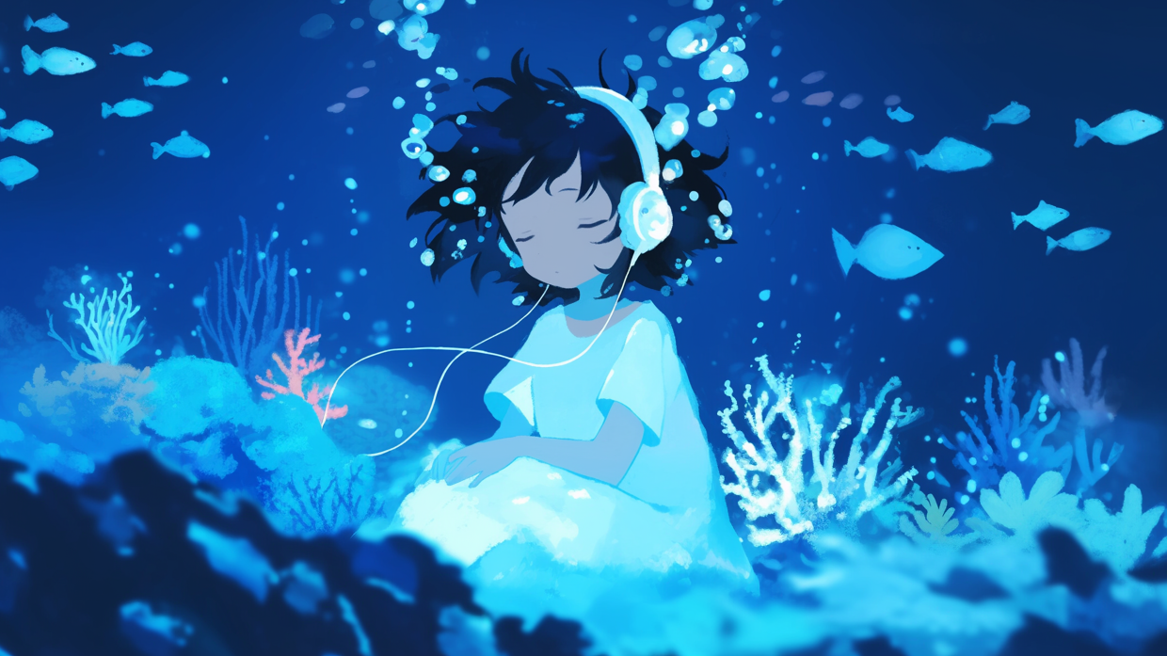
Healing Music
-静寂をなぞる泡音-

Slide 27
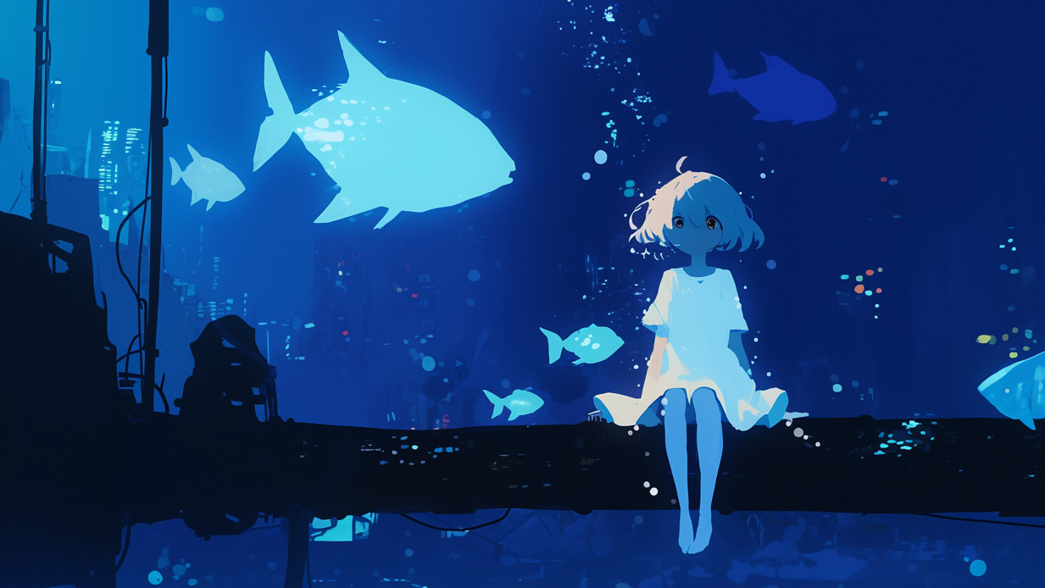
Healing Music
-水底に沈む街-

Slide 28
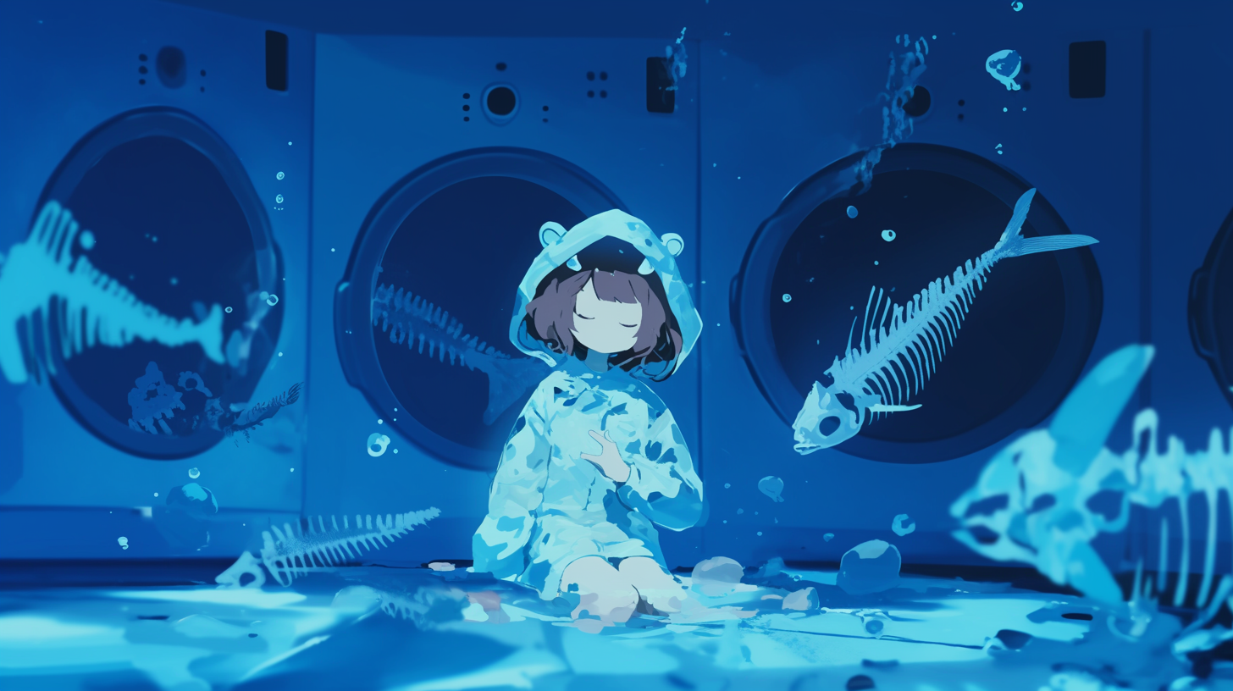
Healing Music
-深海魚も眠る時間-

Slide 29
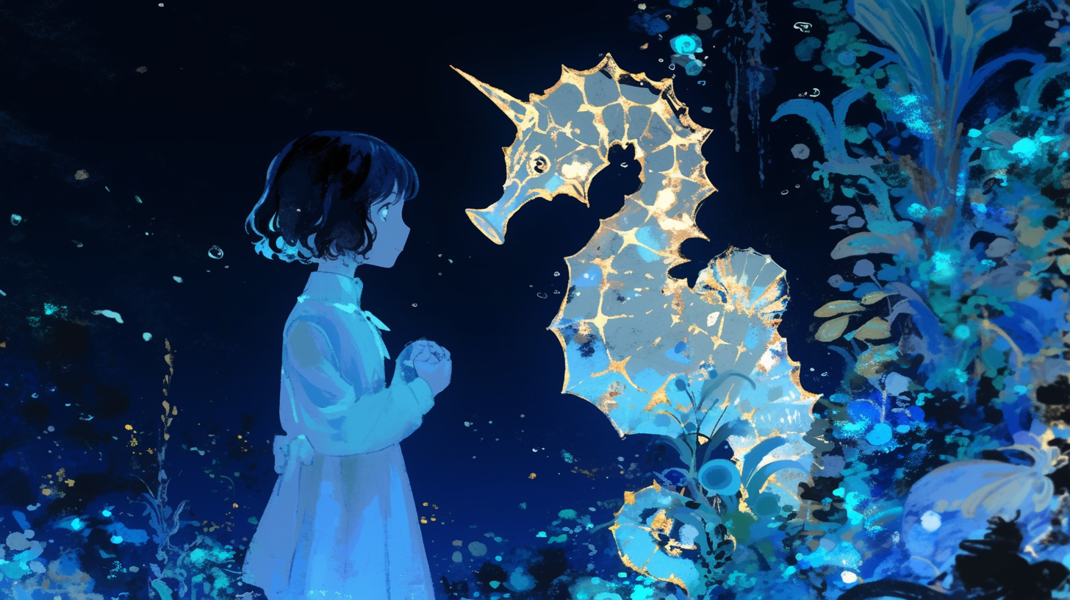
Healing Music
-蒼き深淵の底-

Slide 30

Healing Music
-水没する意識-

Slide 31

Healing Music
-忘れられた海域-

Slide 32
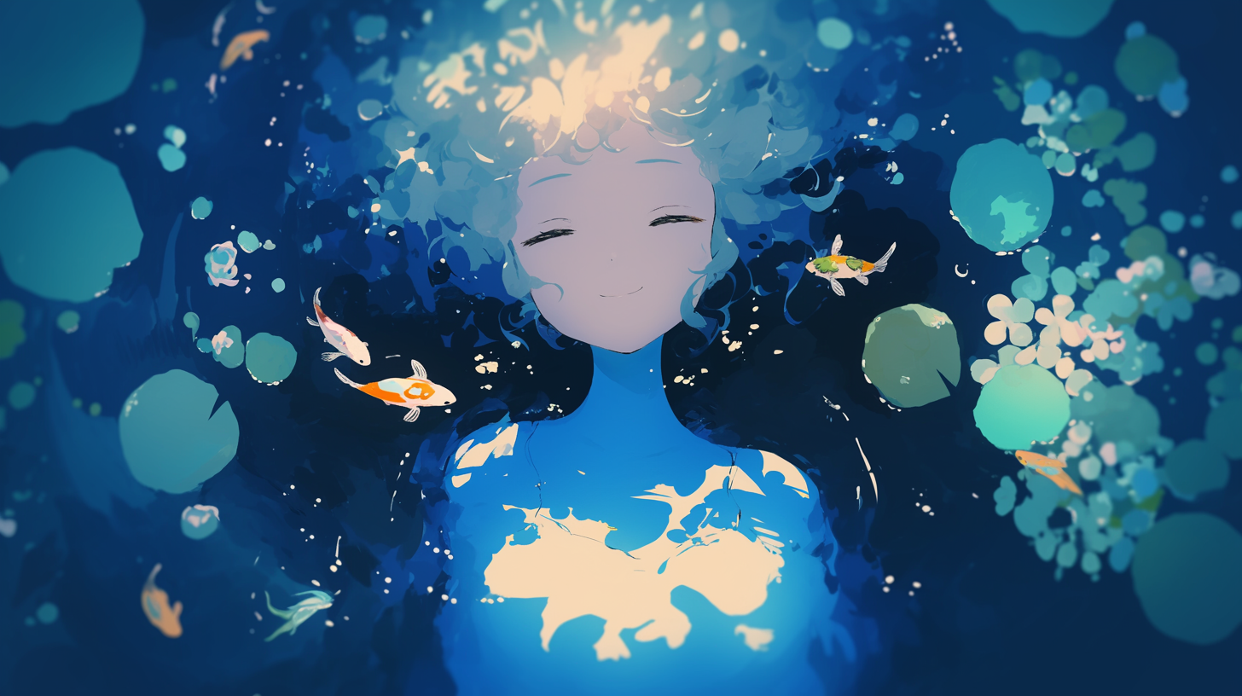
Healing Music
-水に溶ける微睡み-

Slide 33
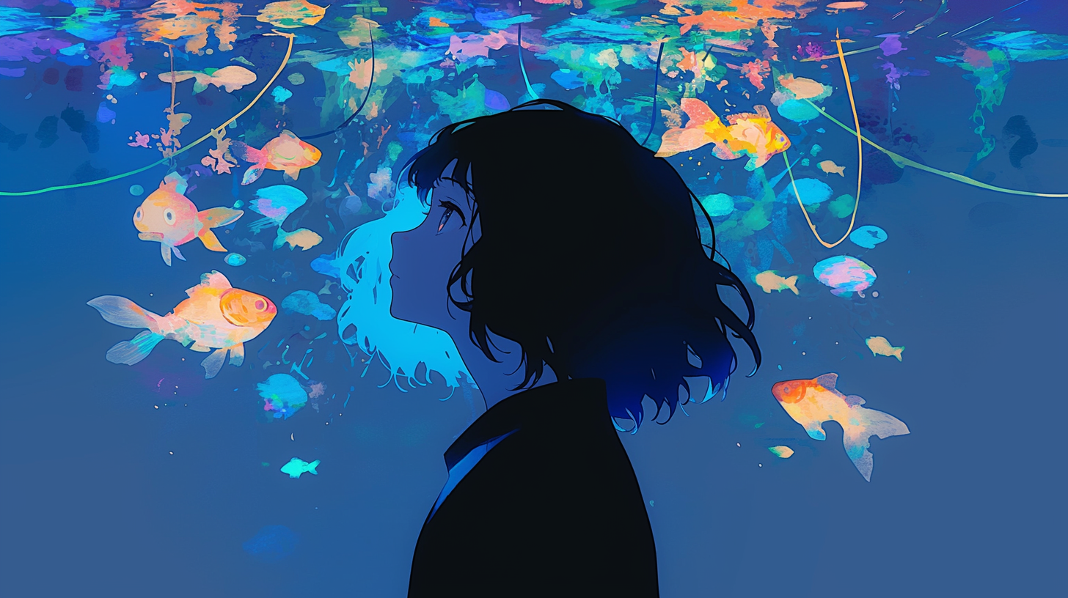
Healing Music
-凪の海と熱帯魚-

Slide 34

Healing Music
-海の記憶の断片-

Slide 35
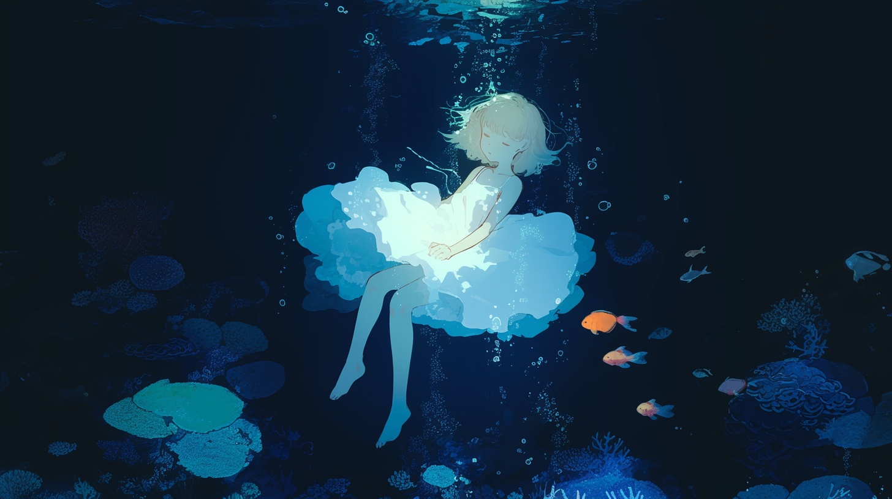
Healing Music
-月光の届かぬ水底-

Slide 36

Healing Music
-海中遊泳-

Slide 37
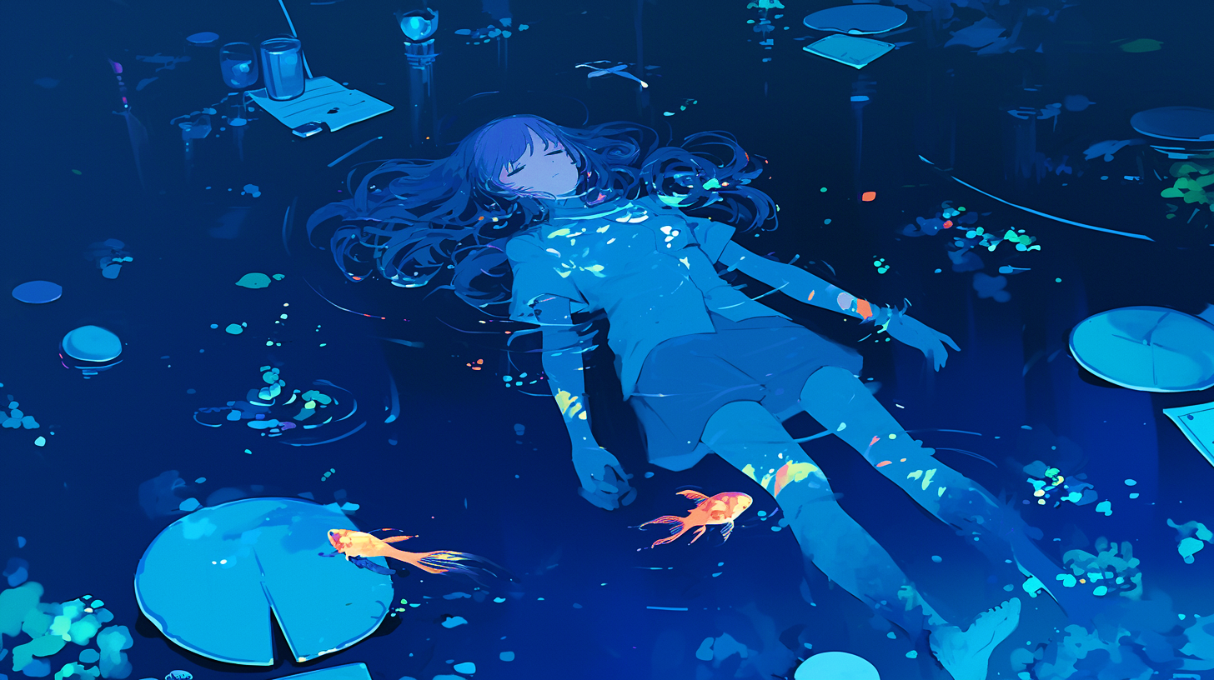
Healing Music
-藍色の子守唄-

Slide 38
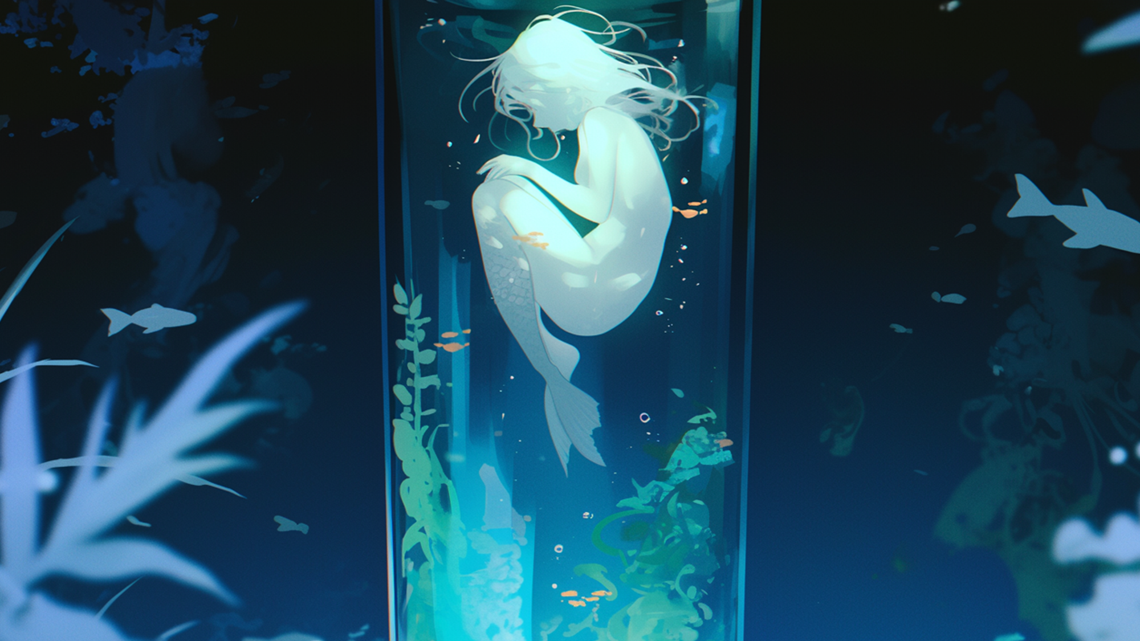
Healing Music
-水精の揺籠-

Slide 39
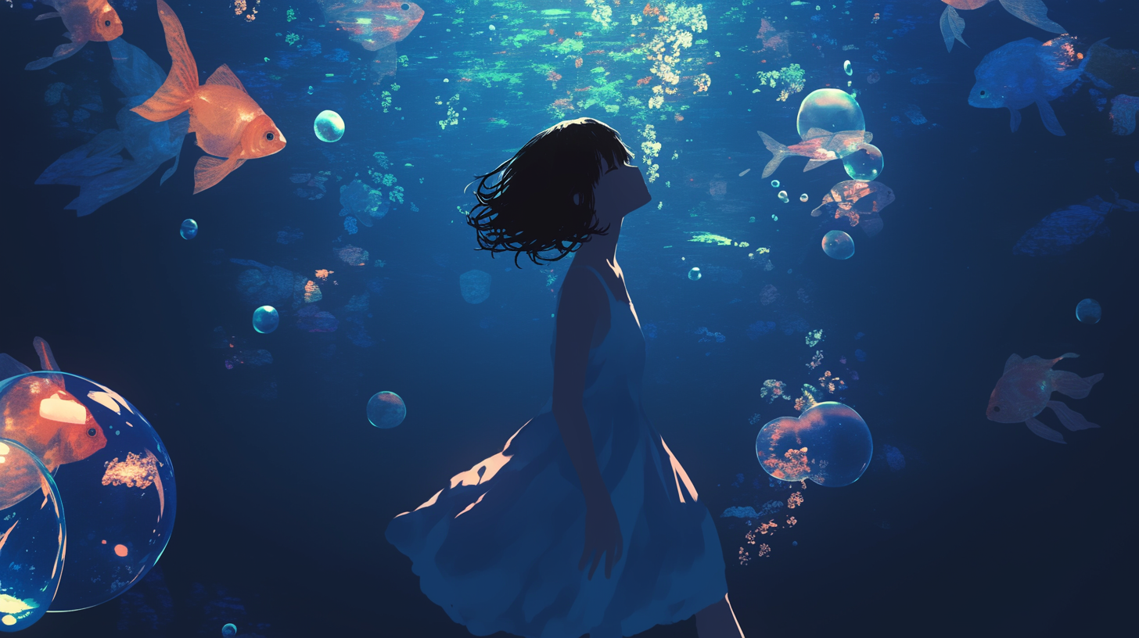
Healing Music
-泡沫の夢路-

